Slide 1
Movie Data Analysis
Archana Subramanian

Slide 2
Objective
To analyse movie datasets.
To provide meaningful insights on movies and their corresponding IMDB ratings.
To draw effective analysis and conclusions from the analysis made on movie datasets.

Slide 3
Dataset Sources:
For this scenario, I used two datasets based on the Movies domain. They are:
IMDB 5000 movies dataset - https://www.kaggle.com/carolzhangdc/imdb-5000-movie-dataset
This dataset consisted of all movie related information between the years of 1916 to 2016. It contained information like Director, Actor, Budget, Duration of the film, Year of release etc.
Movie Ratings Dataset - https://www.kaggle.com/raidevesh05/movie-ratings-dataset
This dataset contained information that included movie name, release year, IMDB scores, votes and metascore.

Slide 4
Analysis Performed:
I tried to correlate multiple factors that contributed to the available rating of a film, the genres of film and a specific actor’s data.
I also tried to relate how the year and movies are related and formed a trend with them.
I tried to analyse the ratings of the movies along with the budget.
I tried to plot the yearly distribution of movies across the globe and filtering the data in Power BI using year, making it interactive.

Slide 5
Actions on data:
The datasets chosen were not readily usable. There had to be some minor levels of pre-processing to be done, which included:
Removing duplicate records from both datasets
Removing special characters from the datasets which were present when downloading.
Handling nulls in key columns.
Identifying and setting key/ common columns between the datasets (in our case: Movie title)
Modifying the genre column in order to consider only the primary genre of the movie.

Slide 6
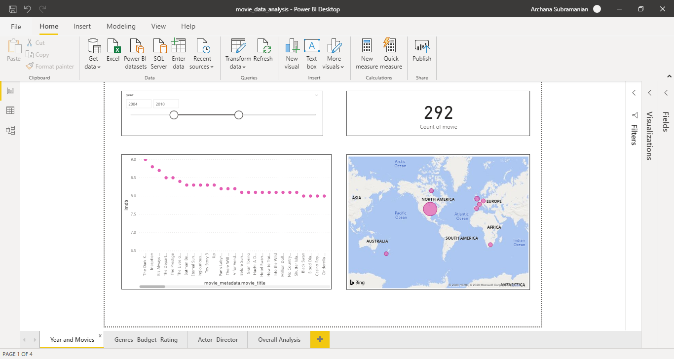
Insights:
Filter movies by year and country of making and show movie-wise rating. This shows the popularity of movies based on country of make.

Slide 7
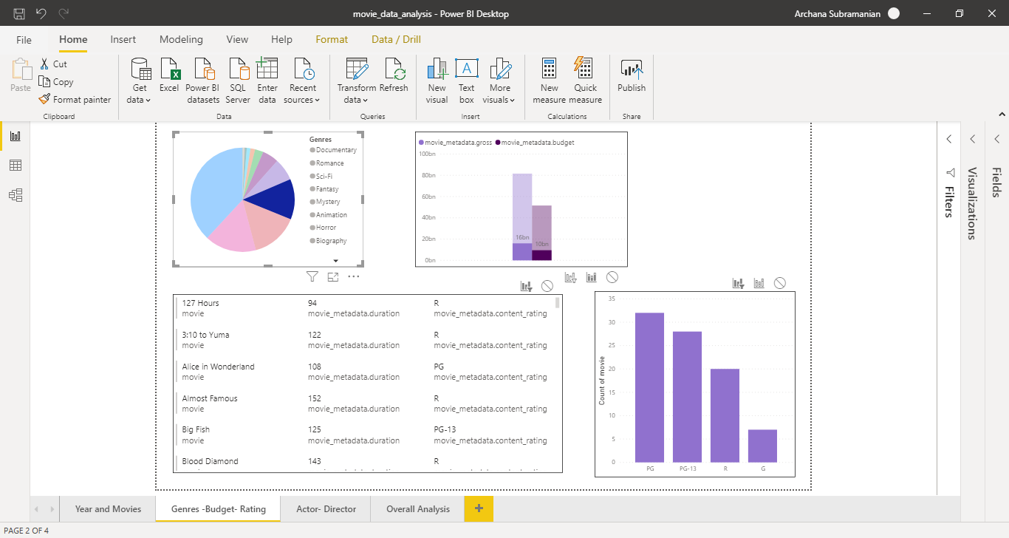
2. Consolidated movies by genre and extracted specific movie information - title, duration and content rating. Formed a graph which shows average rating of movies in each genre and total budget and gross of the same genre. This can be used to determine which type of movies are more expensive and which type of movies generate higher profits.

Slide 8
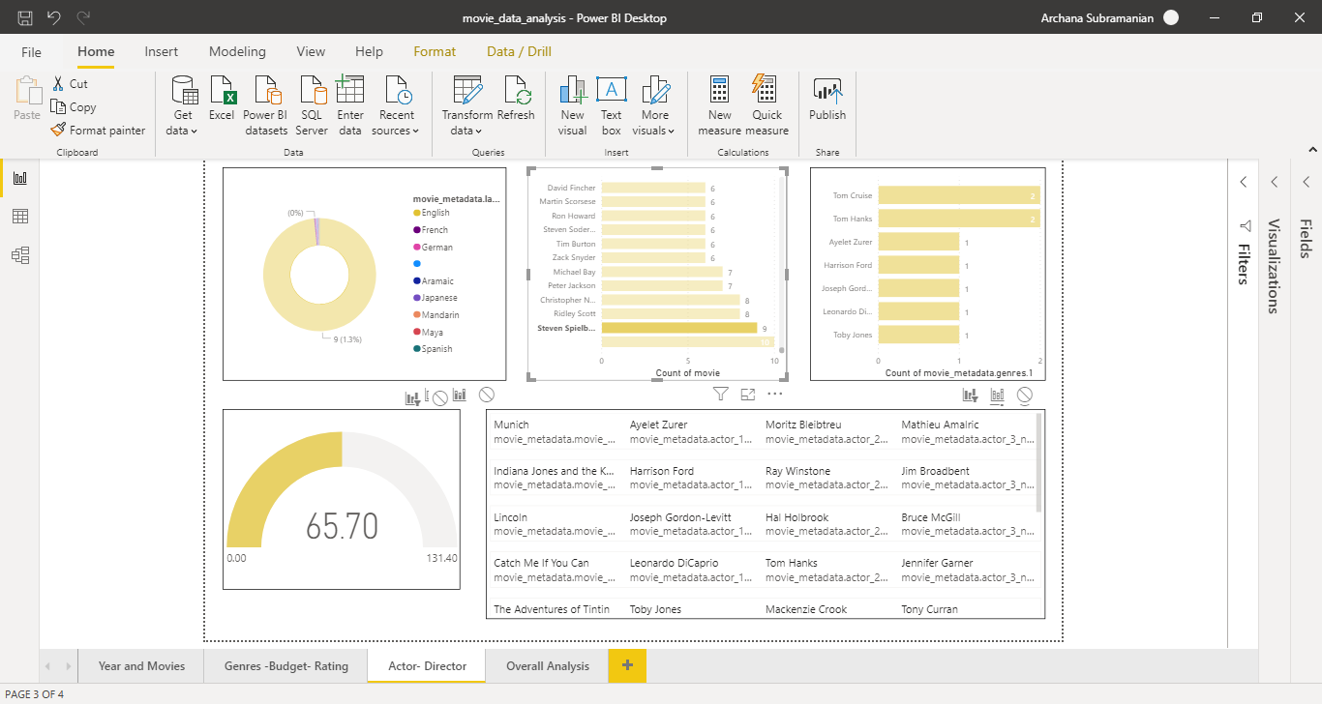
3. First performing a segregation of the data with language, a list of directors who have directed films in that language is displayed. Selecting a director shows the list of movies he has directed along with the actor, a bar chart which shows the actor and the list of genres he has acted in and the average IMDB score or that director. This can be useful in analysing the major genres of a specific director and his/her IMDB trends.

Slide 9
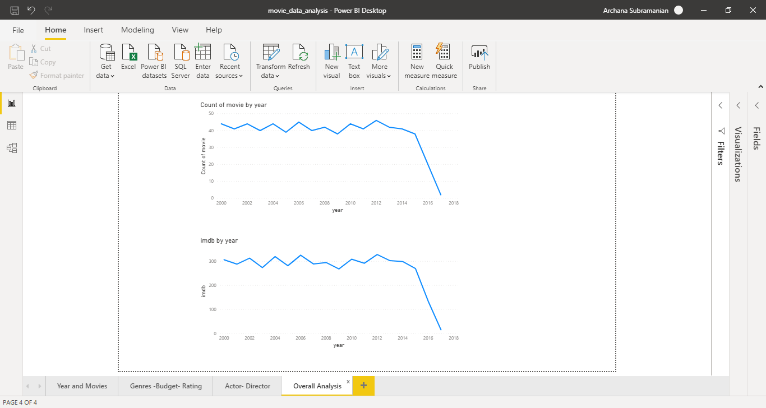
4. An overall review of how IMDB rating and count of movies have changed over the years are displayed as line charts. This can be used to predict future trends.

Slide 10
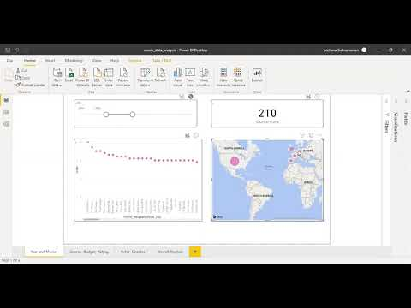
YouTube link:
Please find the below Youtube link to view the interaction and working of this report: https://youtu.be/kPMkhlHd26g

Slide 11
Conclusion:
From the insights:
It was evident that the movie trends have increased over the years and so has the variety and genres.
It is also observed that budget of the movie has no correlation to whether a movie has high rating or not.
Also, any relationship trends between an actor and director was able to be determined.
Popularity was also largely based on the country of release of the movie.
Although I was new to Power BI and wasn’t completely familiar with its interface and features, I was able to learn from the documentation and the system’s interactiveness.
I learnt that there can be several levels of reporting and analysis that can be done on any dataset using Power BI. Even though I was not able to exploit all its features in this use case, I would love to get more experience and exposure to learn more and implement highly interactive BI reports that helps comprehend complex data.

